Slide 1




WordPress Introduction
Using WordPress.com
WP Installation, XAMPP, PHP, MySQL
Domains and WP Hosting
WordPress
Setup
SoftUni Team
Technical Trainers
Software University
http://softuni.bg

Slide 2



Table of Contents
WordPress Overview
Using WordPress.com
Installing XAMPP
Installing WordPress
Setup MySQL Database
Setup WP Software
Hosting WP in Internet
Register Own Domain

Slide 3
Have a Question?
sli.do #wp-softuni

Slide 4

WordPress Overview

Slide 5
What is CMS System?
CMS == Content Management Systems
Software to create, run and maintain Web sites in Internet
Add / edit / delete pages, documents, articles, images, files, downloads, forms, polls, events, e-commerce, …
Manage navigation, menus, widgets, users, permissions, SEO, …
Powerful WYSIWYG content editors
Popular CMS software: WordPress, Drupal, Joomla
Popular CMS services: WordPress.com, Wix.com, Google Sites

Slide 6
What is WordPress?
WordPress – the world's leading Web CMS system
WP powers 27% of all Web sites in Internet (March 2017)
Open-source (free) software – https://wordpress.org
Runs on top of PHP + MySQL
Stores all Web site contents in the database
Images / documents / files in the file system
Very powerful, easy-to-use, SEO friendly
Very large community – thousands of themes, plugins, …

Slide 7
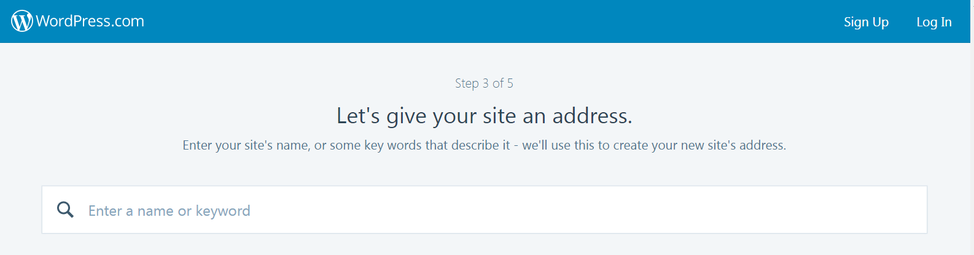
WordPress.com
Run Your Own Site / Blog in 5 Minutes

Slide 8
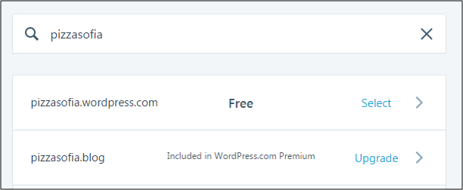
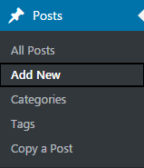
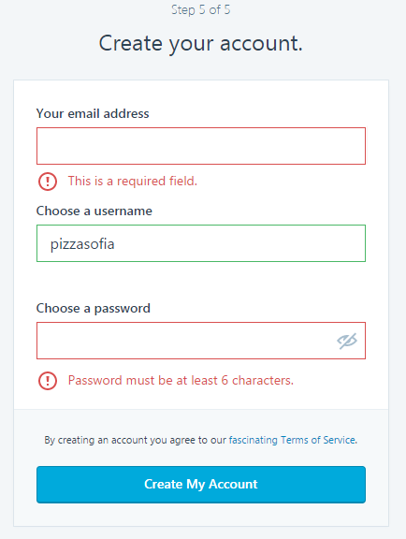
WordPess.com
Creating a new Web site
Open wordpress.com
Enter your site name
Create a new account
Open WP admin panel:
https://pizzasofia.wordpress.com/wp-admin/
Create a few posts
Add content, images, tags, categories, …
site name

Slide 9
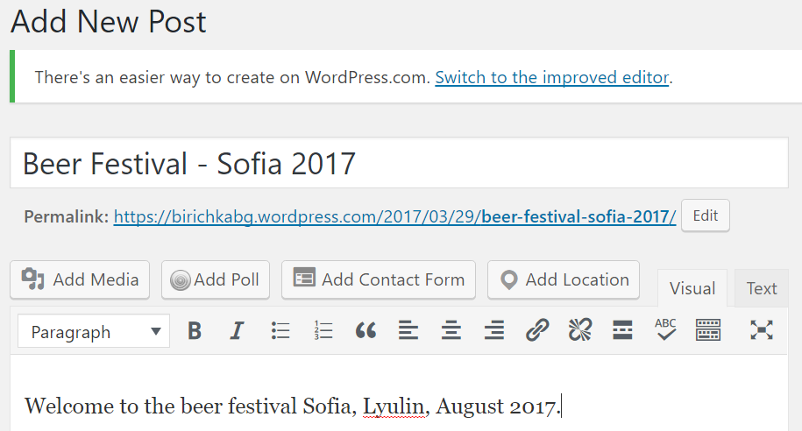
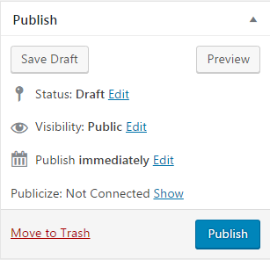
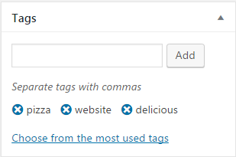
WordPress.com – Creating a New Post

Slide 10

Practice: Create a WordPress.com Site
Live Exercises in Class (Lab)

Slide 11
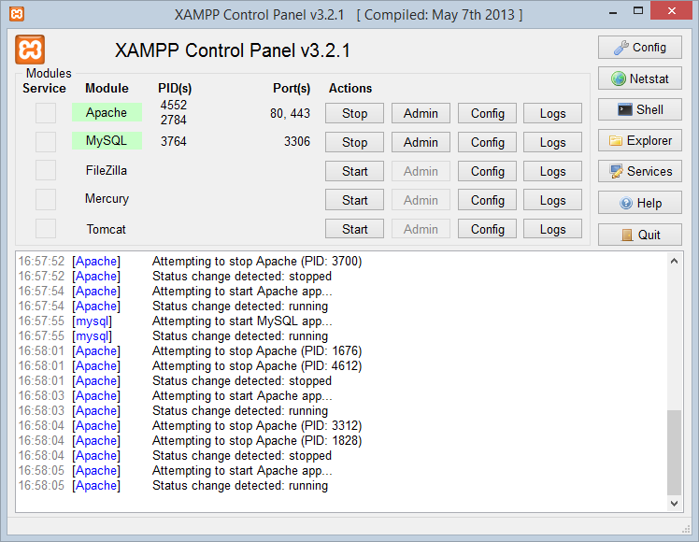

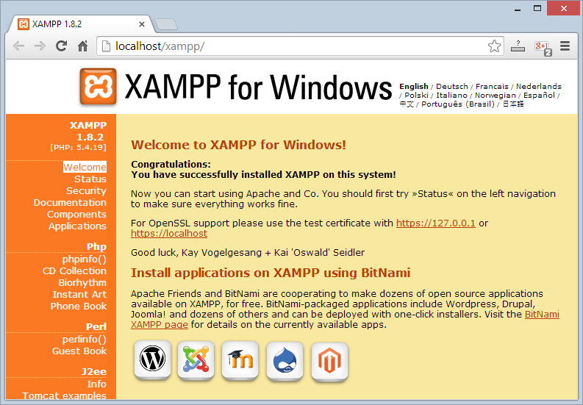
XAMPP
Install and Configure XAMPP

Slide 12
What is XAMPP?
XAMPP (/ˈzæmp/ or /ˈɛks.æmp/)
PHP + MySQL (MariaDB) + Apache + tools
Apache Web server + OpenSSL
MySQL database + phpMyAdmin
Scripting languages: PHP and Perl
Admin panel for simplified administration
Free, open source software package
Runs on Windows, Linux and Mac OS X

Slide 13
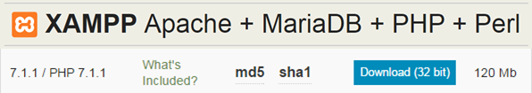
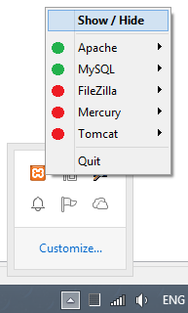
Download, Install and Run XAMPP
Downloading XAMPP:
https://www.apachefriends.org/download.html
Installing XAMPP for Windows:
Download the installer (run it as administrator)
Typical installation: [Next] →[Next] → [Finish]
Running XAMPP
XAMPP start as a tray icon

Slide 14
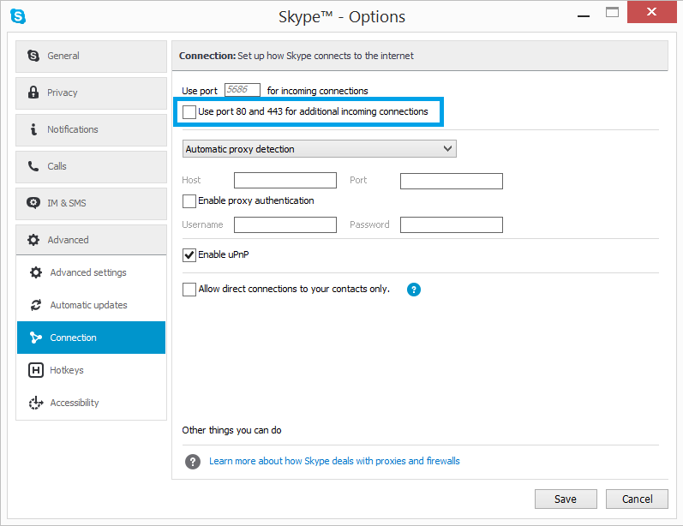
XAMPP: Collision with Port 80 / Skype
XAMPP needs TCP port 80 to run Apache
Ensure port 80 is free
Stop Skype
Or configure it for different port
Stop IIS / torrents / other network software

Slide 15
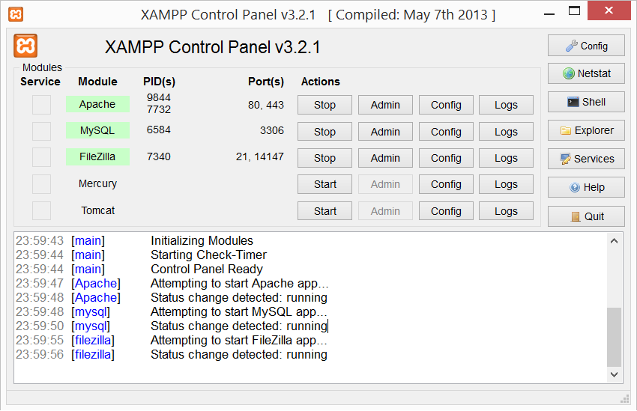
XAMPP Control Panel
Used TCP ports
Windows process IDs
System messages (logs)

Slide 16
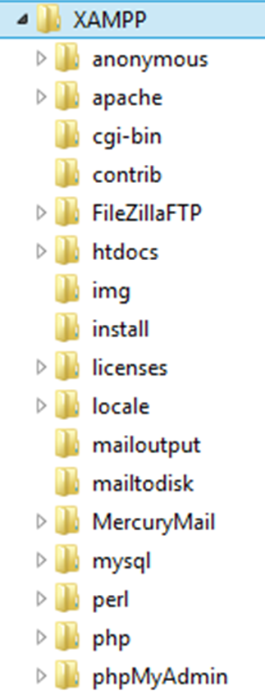




XAMPP Directories
Location of public HTML files (document root)
./htdocs
Location of Apache Web server
./apache
Location of PHP interpreter
./php
Location of MySQL database server
./mysql

Slide 17
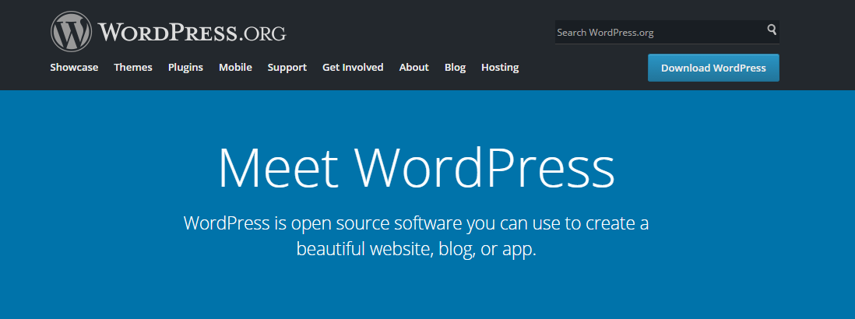
Installing WordPress

Slide 18
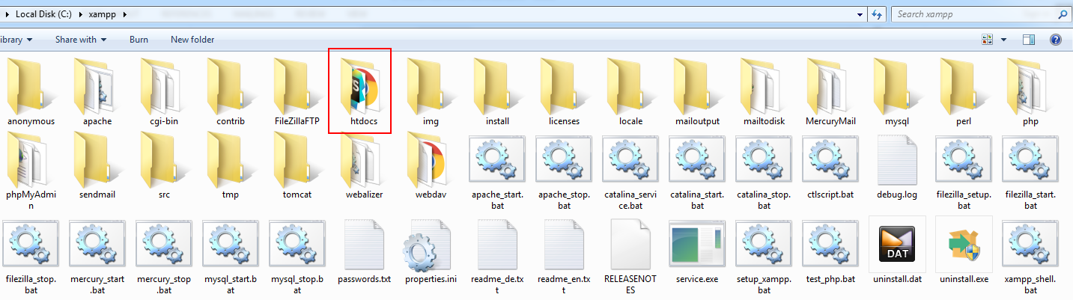
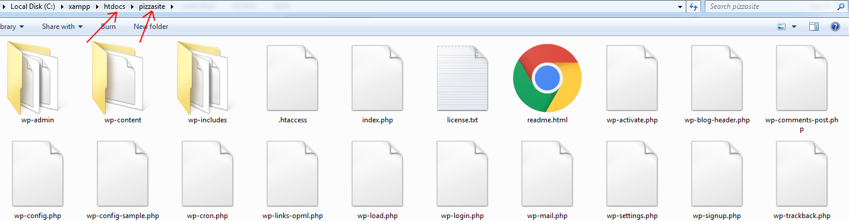
WordPress.org
Go to https://wordpress.org and download WordPress (as ZIP)
Open C:\xampp\htdocs and extract WordPress.zip

Slide 19
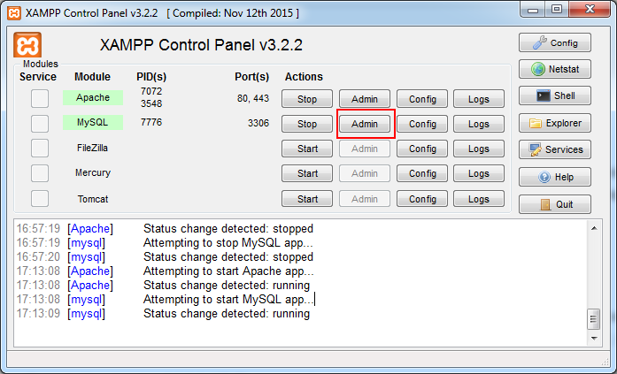
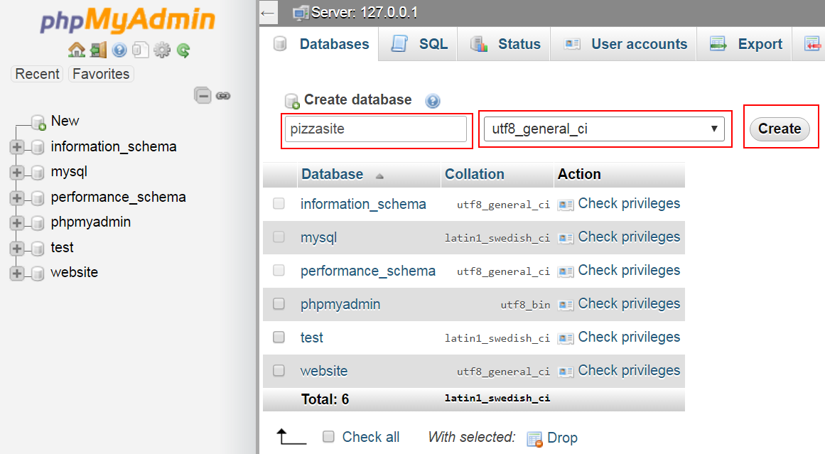
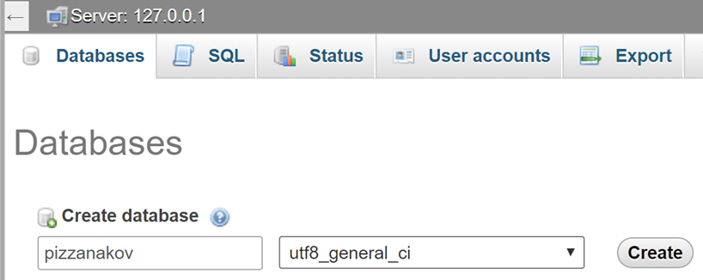
Setup a MySQL Database
Start XAMPP
Open phpMyAdmin
Create a new database

Slide 20
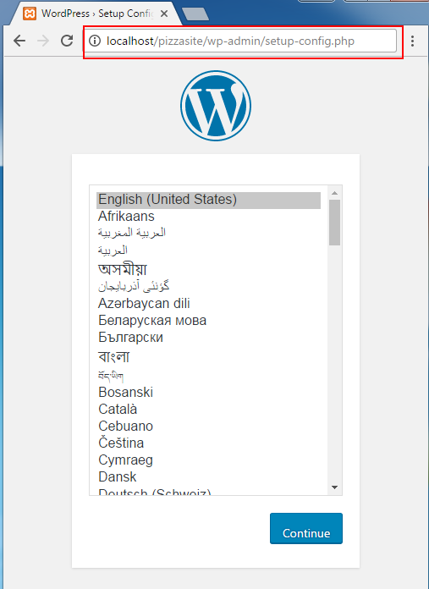
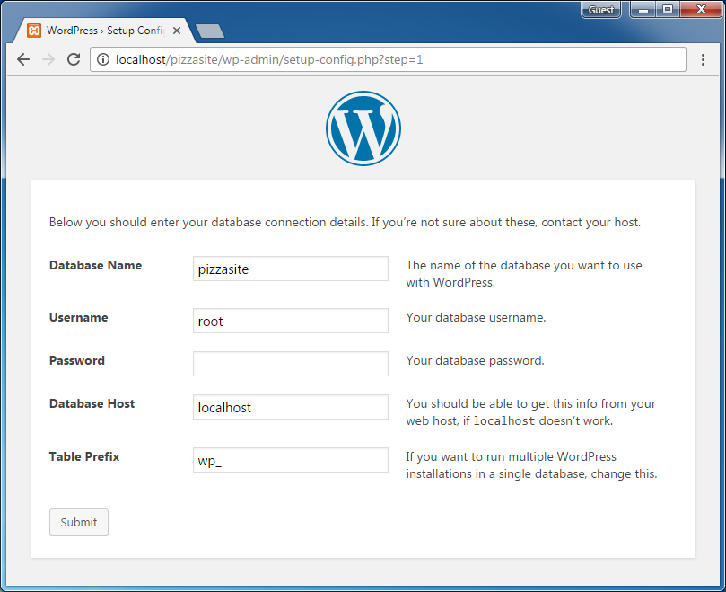
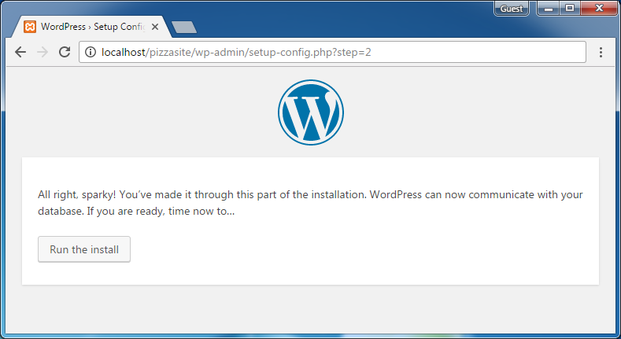
Setup WordPress
Configure your WordPress
http://localhost/pizzasite/wp-admin/setup-config.php
Follow the WP installation steps:
site name

Slide 21
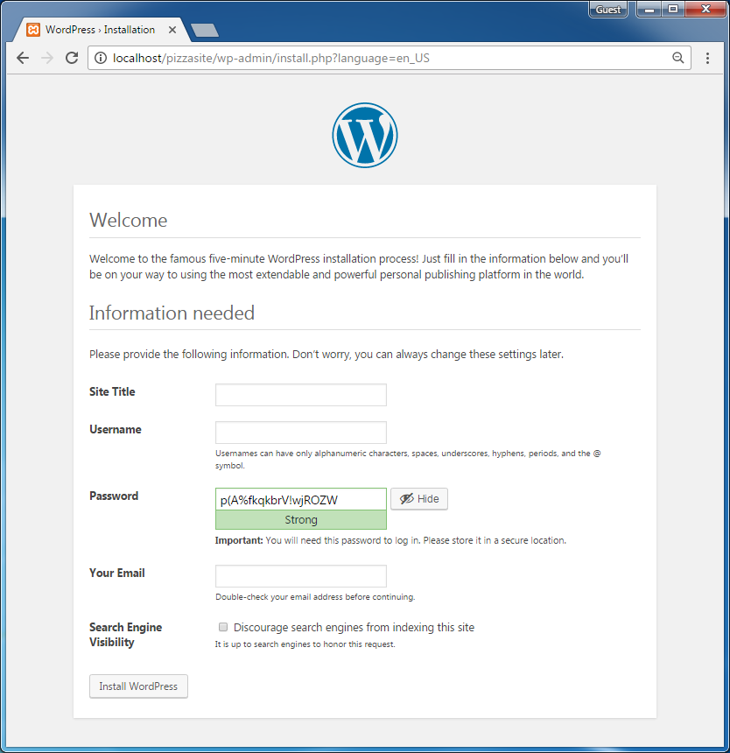
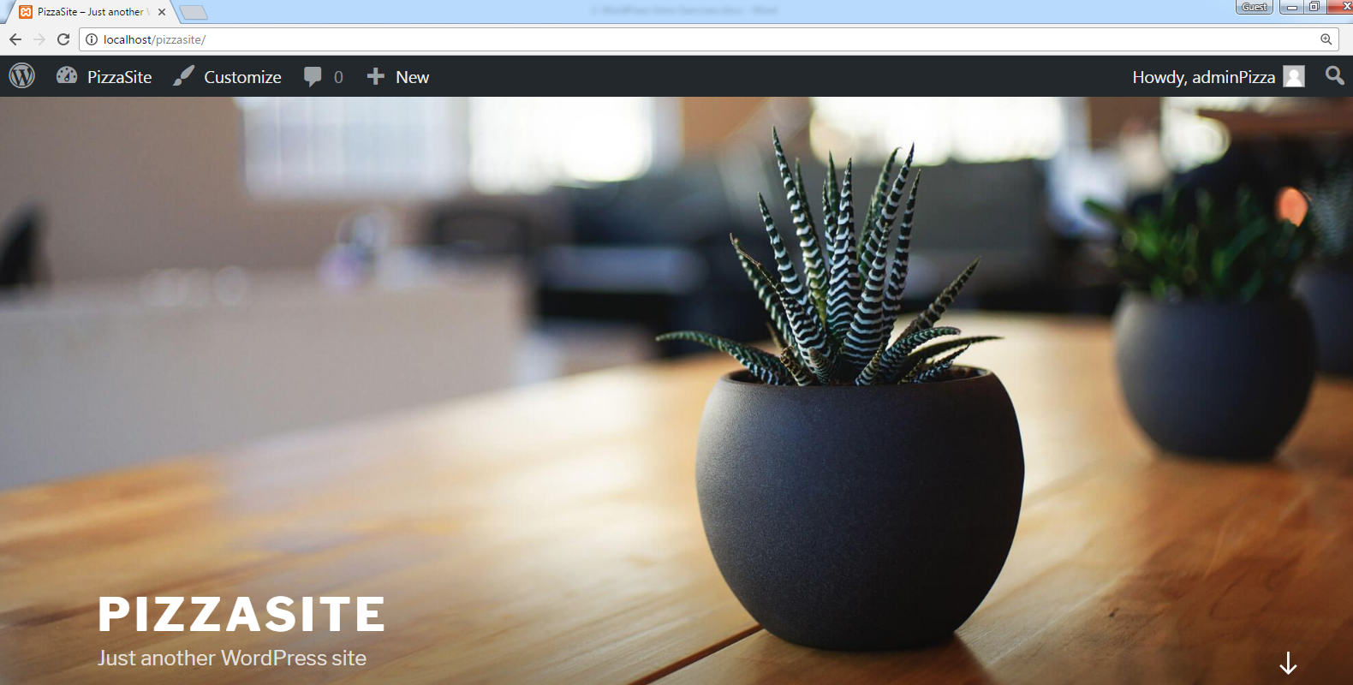
WordPress Installation

Slide 22
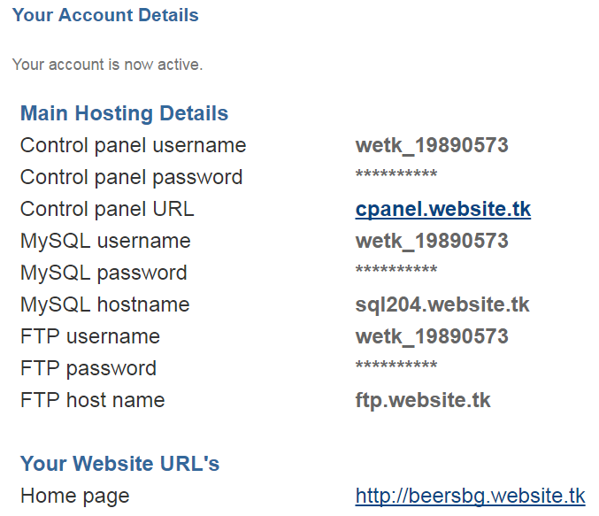
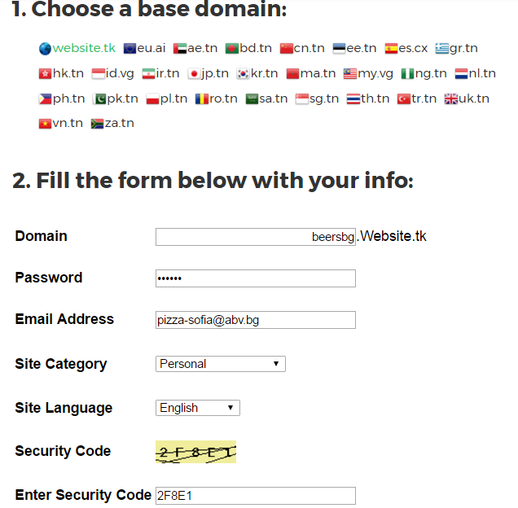
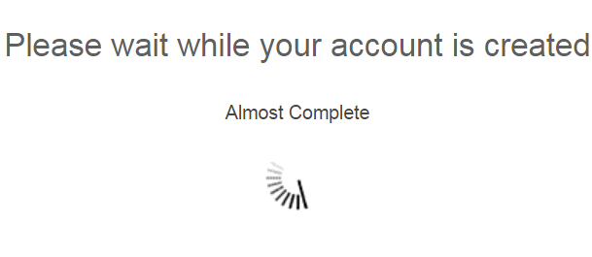
Web Hosting and cPanel
Purchase your own Web hosting
Or register for a free Web hosting with cPanel from http://freesubdomain.org

Slide 23
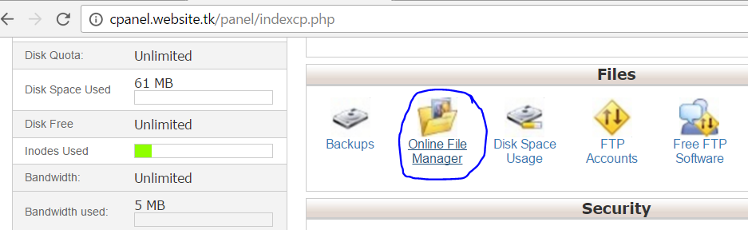
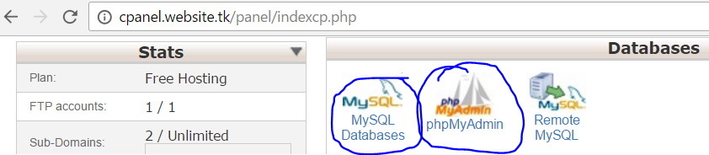
Using cPanel
Managing files and folders from cPanel
Managing MySQL databases:

Slide 24
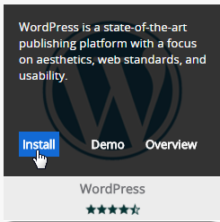
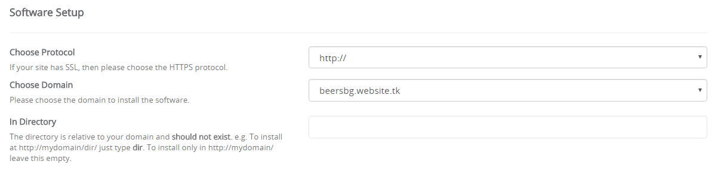
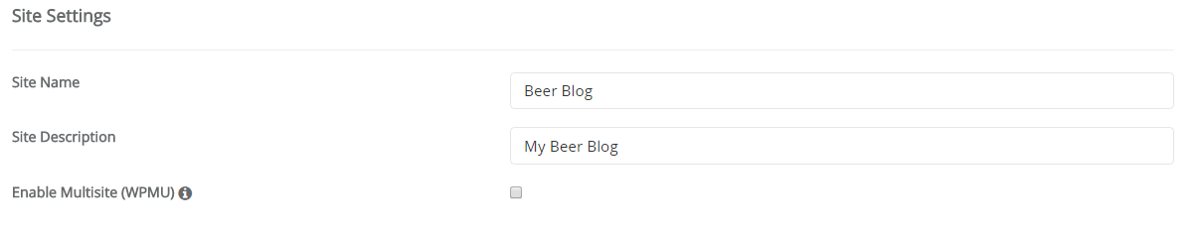
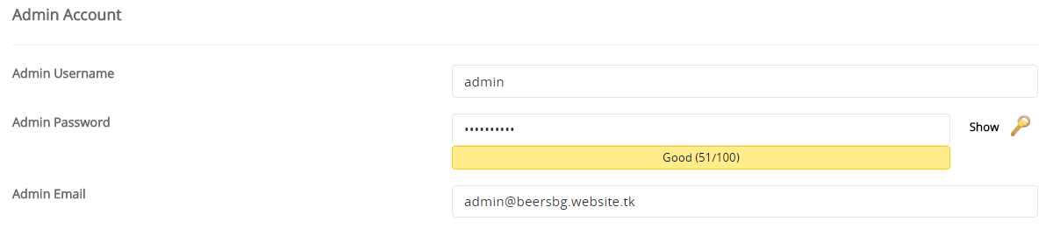
Install WP using Softaculous

Slide 25
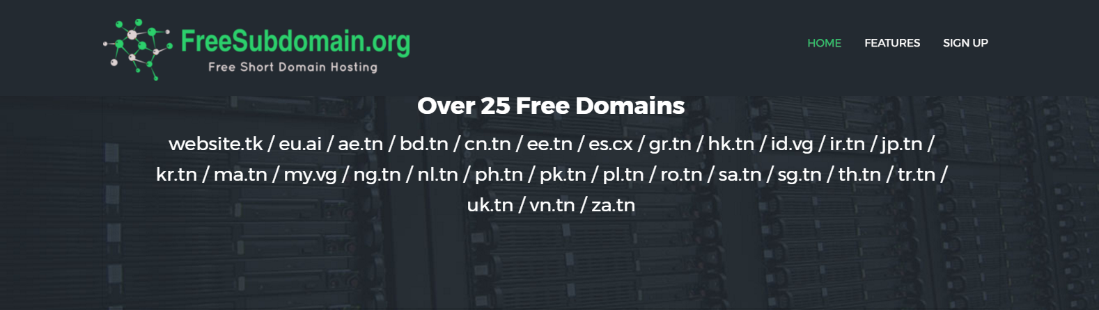
Custom Domains
Register Your Own Domain Name

Slide 26
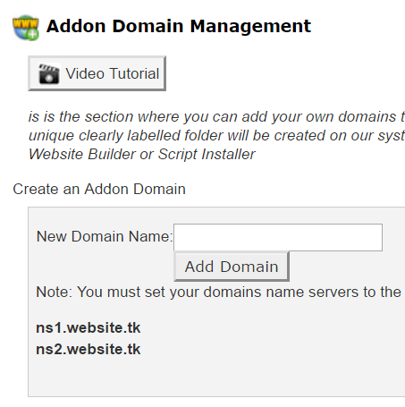
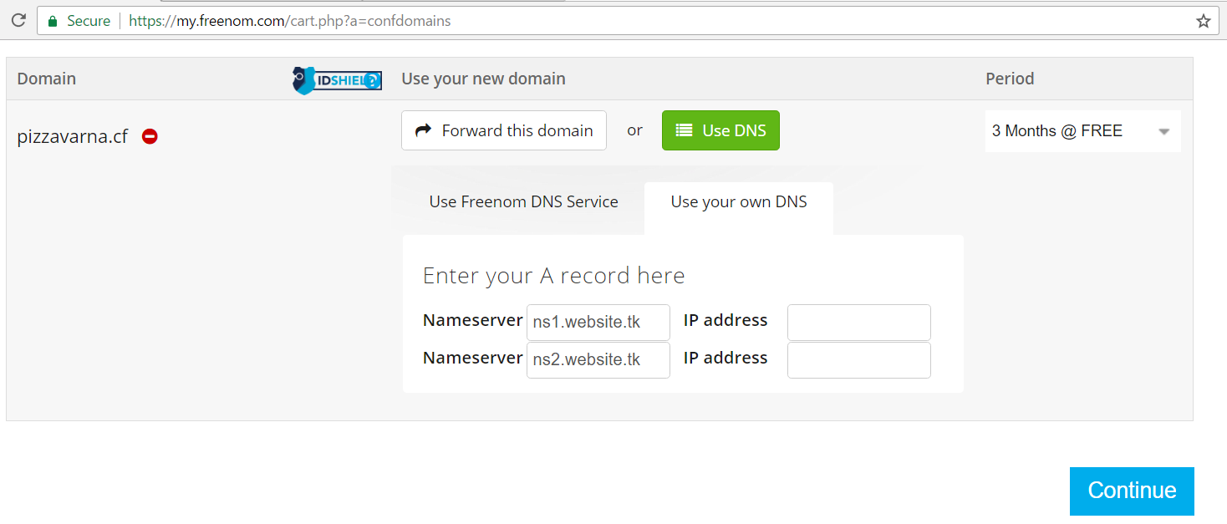
Free Domain from Freenom
Register a free domain from http://www.freenom.com
Enter your hosting name servers (cPanel shows them)
Create add-on domain in cPanel
Use DNS servers from website.tk

Slide 27
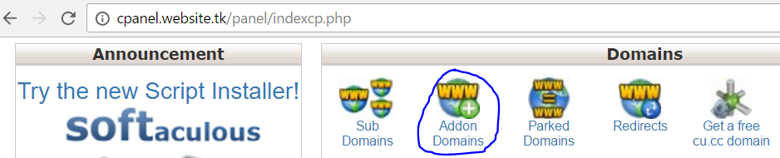
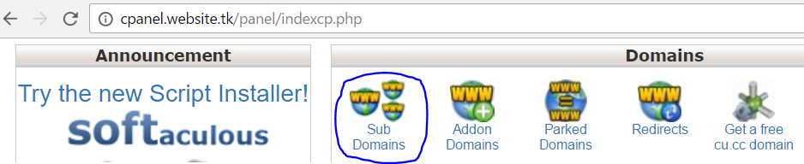
Managing Domains and Sub-Domains
Managing top-level domains from cPanel:
Managing sub-domains from cPanel:

Slide 28

Summary
WordPress is the world's most used CMS system
WordPress.com is cloud-based WordPress site hosting solution
XAMPP runs WordPress on your laptop
Setup MySQL Database
Unzip and setup WordPress
Web hosting keeps your sites in Internet
cPanel is powerful hosting admin panel
Domains allow better URL for your sites

Slide 29








WordPress Introduction
https://softuni.bg/courses/wordpress-basics

Slide 30

License
This course (slides, examples, demos, videos, homework, etc.) is licensed under the "Creative Commons Attribution-NonCommercial-ShareAlike 4.0 International" license

Slide 31





Free Trainings @ Software University
Software University – High-Quality Education, Profession and Job for Software Developers
softuni.bg
Software University Foundation
softuni.org
Software University @ Facebook
facebook.com/SoftwareUniversity
Software University Forums
forum.softuni.bg

